Slide 1

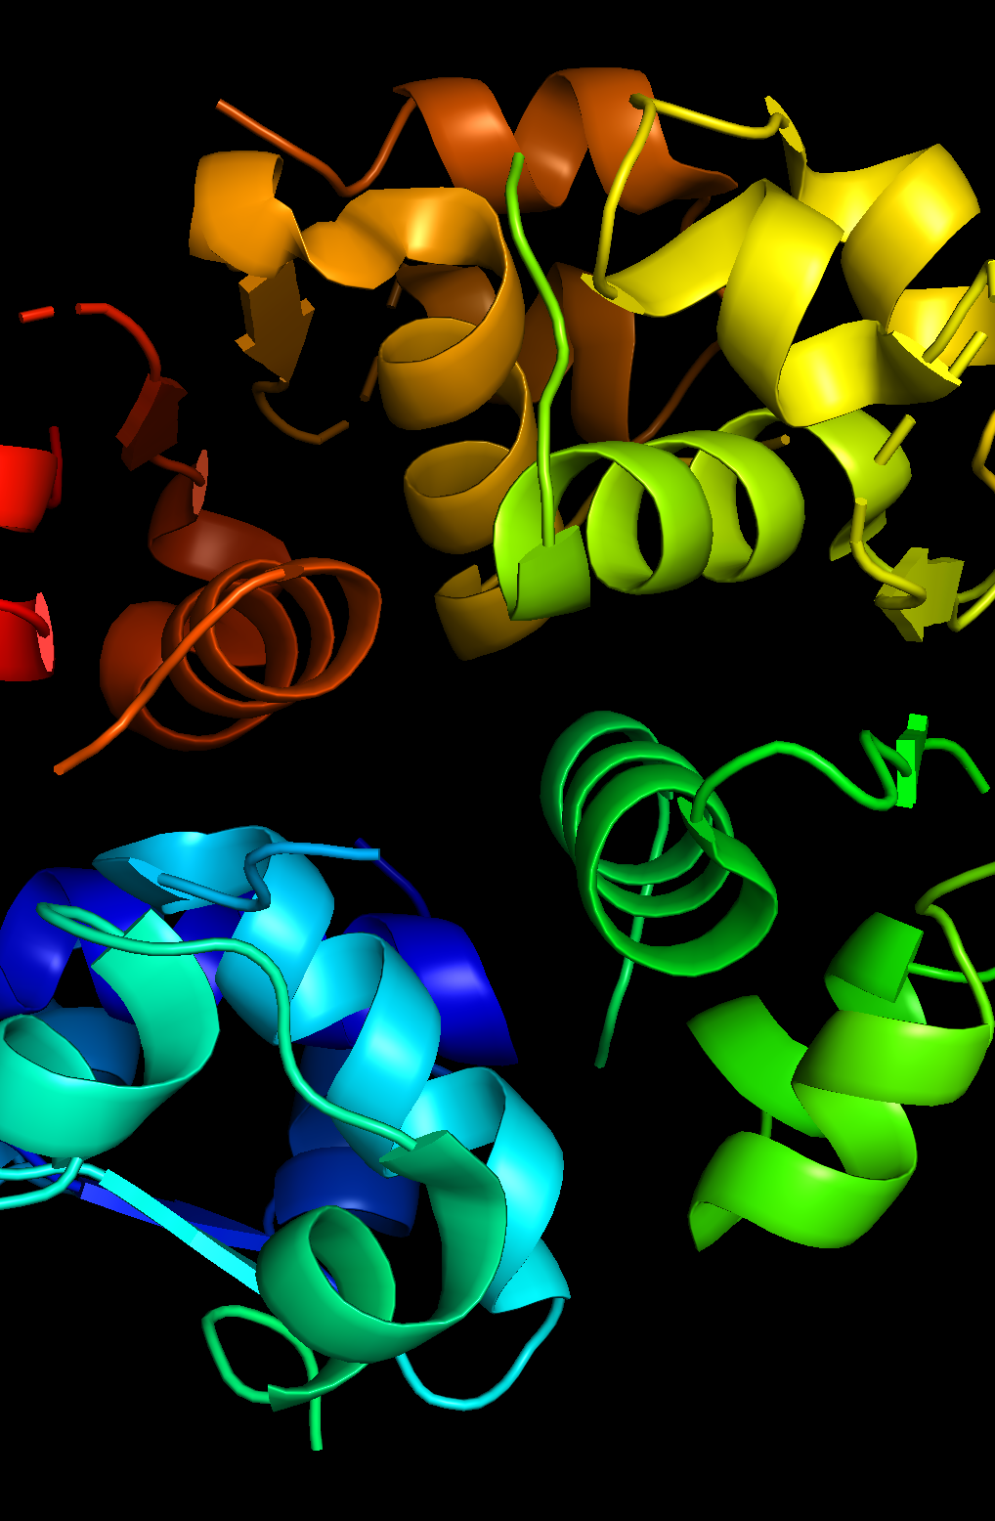
Ultra-stable Single Chain Insulin (SCI-57) Analog
frederick huang

Slide 2
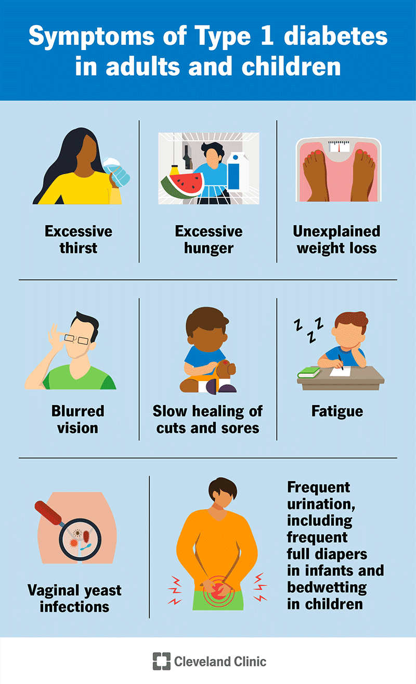
Why this molecule
Millions globally are diagnosed and live with either type 1 (T1D) or 2 (T2D) diabetes.
Projections suggest that total cases could double by 2040.
Need for medication access in low resource settings.
All insulin medication require refrigeration, increasing costs due to manufacturing, transport and delivery.
Medications experience aggregation/fibrillation at sustained above room temperatures.
Increases barrier to access in low resource settings.
Symptoms of diabetes. (1)
Notes:
My motivation behind studying this molecule is based around several factors. As recent as 2022, millions globally are diagnosed and live with either type 1 or 2 diabetes, with several close family members of mine living with the former.
Reports and projections suggest that cases could roughly double by 2040. Insulin, a key molecule at the center of this disease, has had many analogs developed to treat and manage life-threatening symptoms of these conditions.

Slide 3
Origin and Name
Origin: Homo sapiens
Insulin (WT, PDB 1ZNJ)
Homo-hexamers: trimer of dimers
SCI Origin: Artificial
An ultra-stable single-chain insulin analog resists thermal inactivation and exhibits biological signaling duration equivalent to the native protein (modified/synthetic, PDB 5WDM, SCI-57)
Recombinant expression through p.pastoris, individual chains are chemically ligated together.
Notes:
In an effort to address this challenge, researchers have developed an ultra-stable single chain insulin analog as a proof of concept to address the problem of insulin stability in the absence of a cold chain. This ultra-stable single-chain insulin analog is also abbreviated in literature as “SCI-57” or “SCI-a” as they denote a single-chain insulin analog comprised of 57 amino acids. Compared to WT insulin found in humans (homo sapiens), this molecule is artificially made through native chemical ligation or recombinant expression through either p.pastoris or baker’s yeast. Despite promising implications as a proof of concept, SCI-57’s viability has yet to be commercialized, and further studies to evaluate its biol7ogical activity are still under way. As far as I know, there haven’t been any clinical trials that looked at this molecule as a marketable drug.

Slide 4
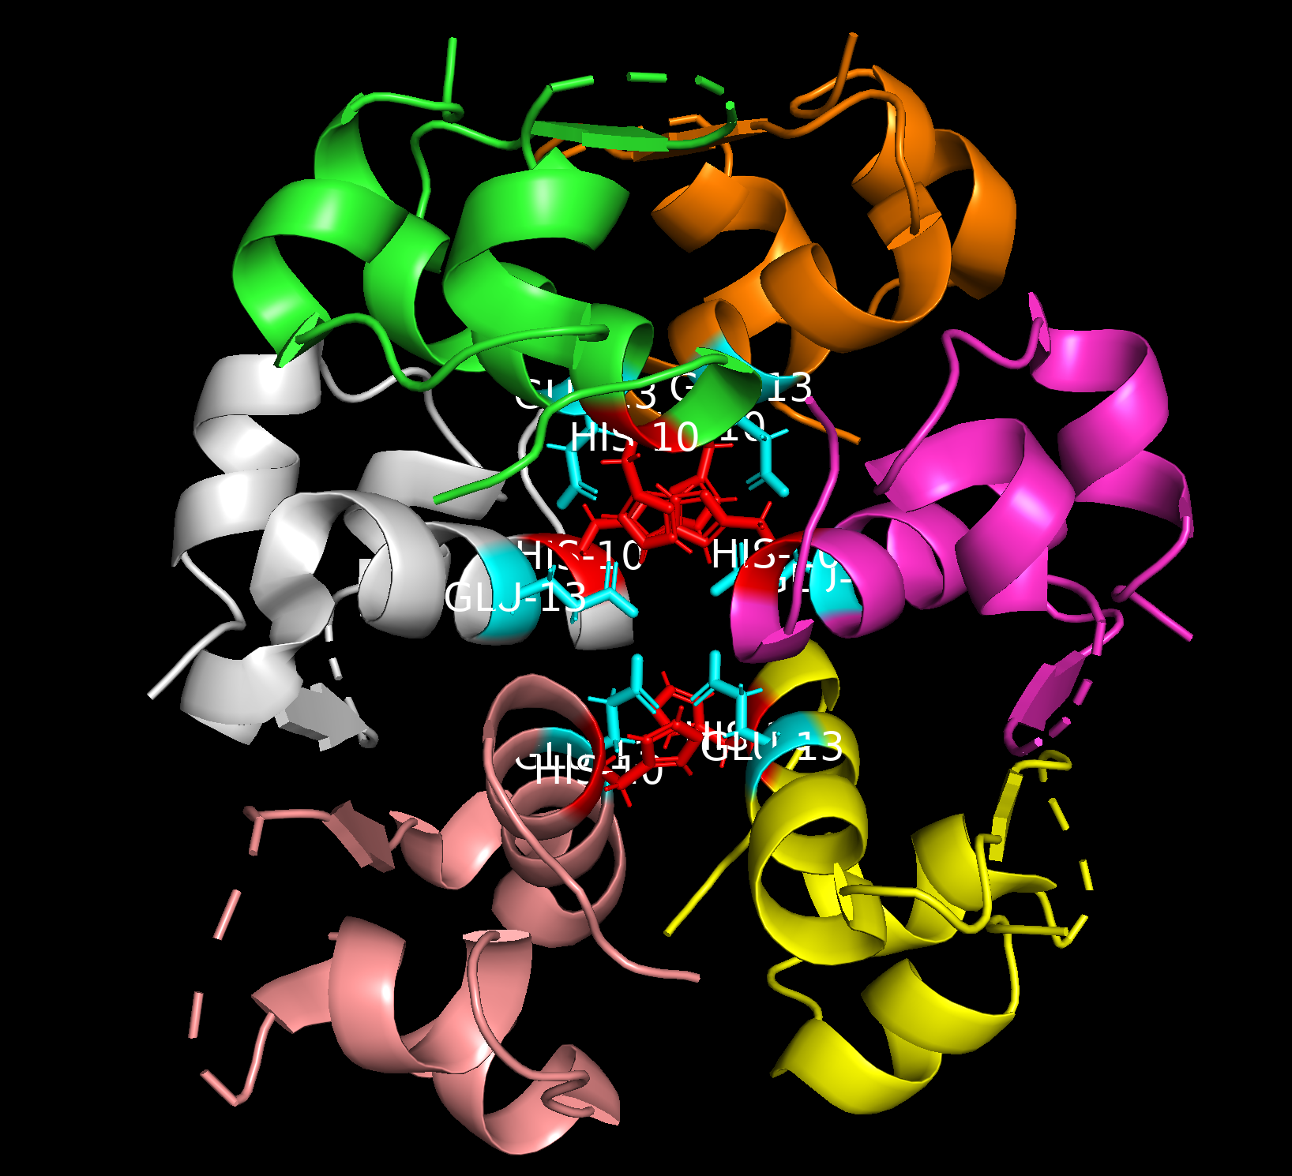
Structural Information
Dimerization/Assembly
HisB10 and GluB13 promote electrostatic interactions between monomers before assembly
HisB10 conserved to prevent mitogenicity
Assembly facilitated by B chain residues interacting
Domains – B and A chain ligated with 6 amino acids
EEGPRR
Binding Residues
Initiated by 3 B chain residues and C linkers
Hydrophobic interactions with receptor molecules
Delocalized electron interactions.
Notes:
EEG - lower isoelectric point to prevent binding to IGFR-1 – prevents cancer
PRR – allows flexibility with glycine to make A and B chain align during receptor binding.

Slide 5
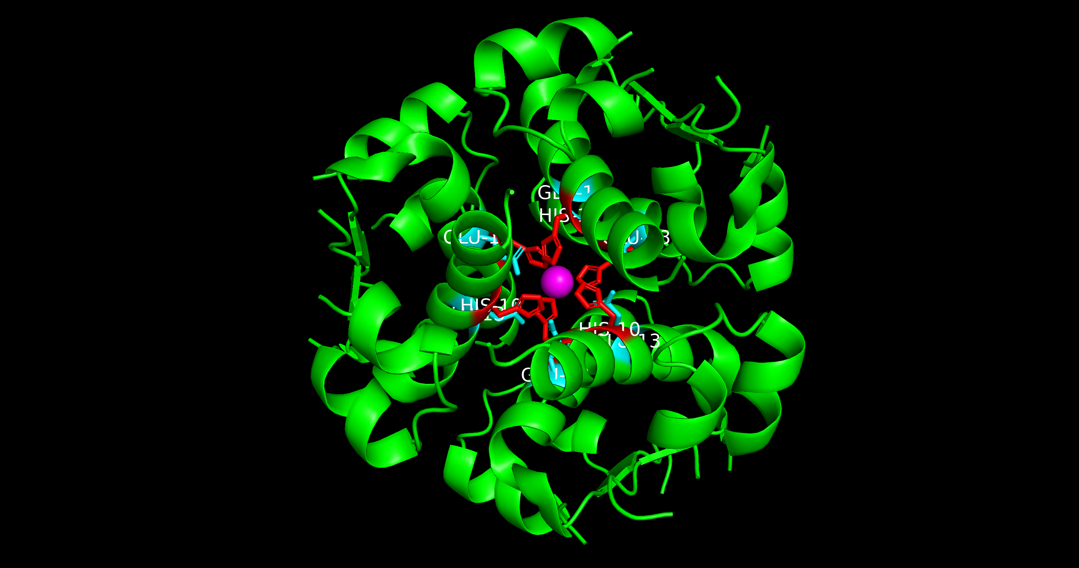
PDB: 1ZNJ
PDB: 5WDM

Slide 6
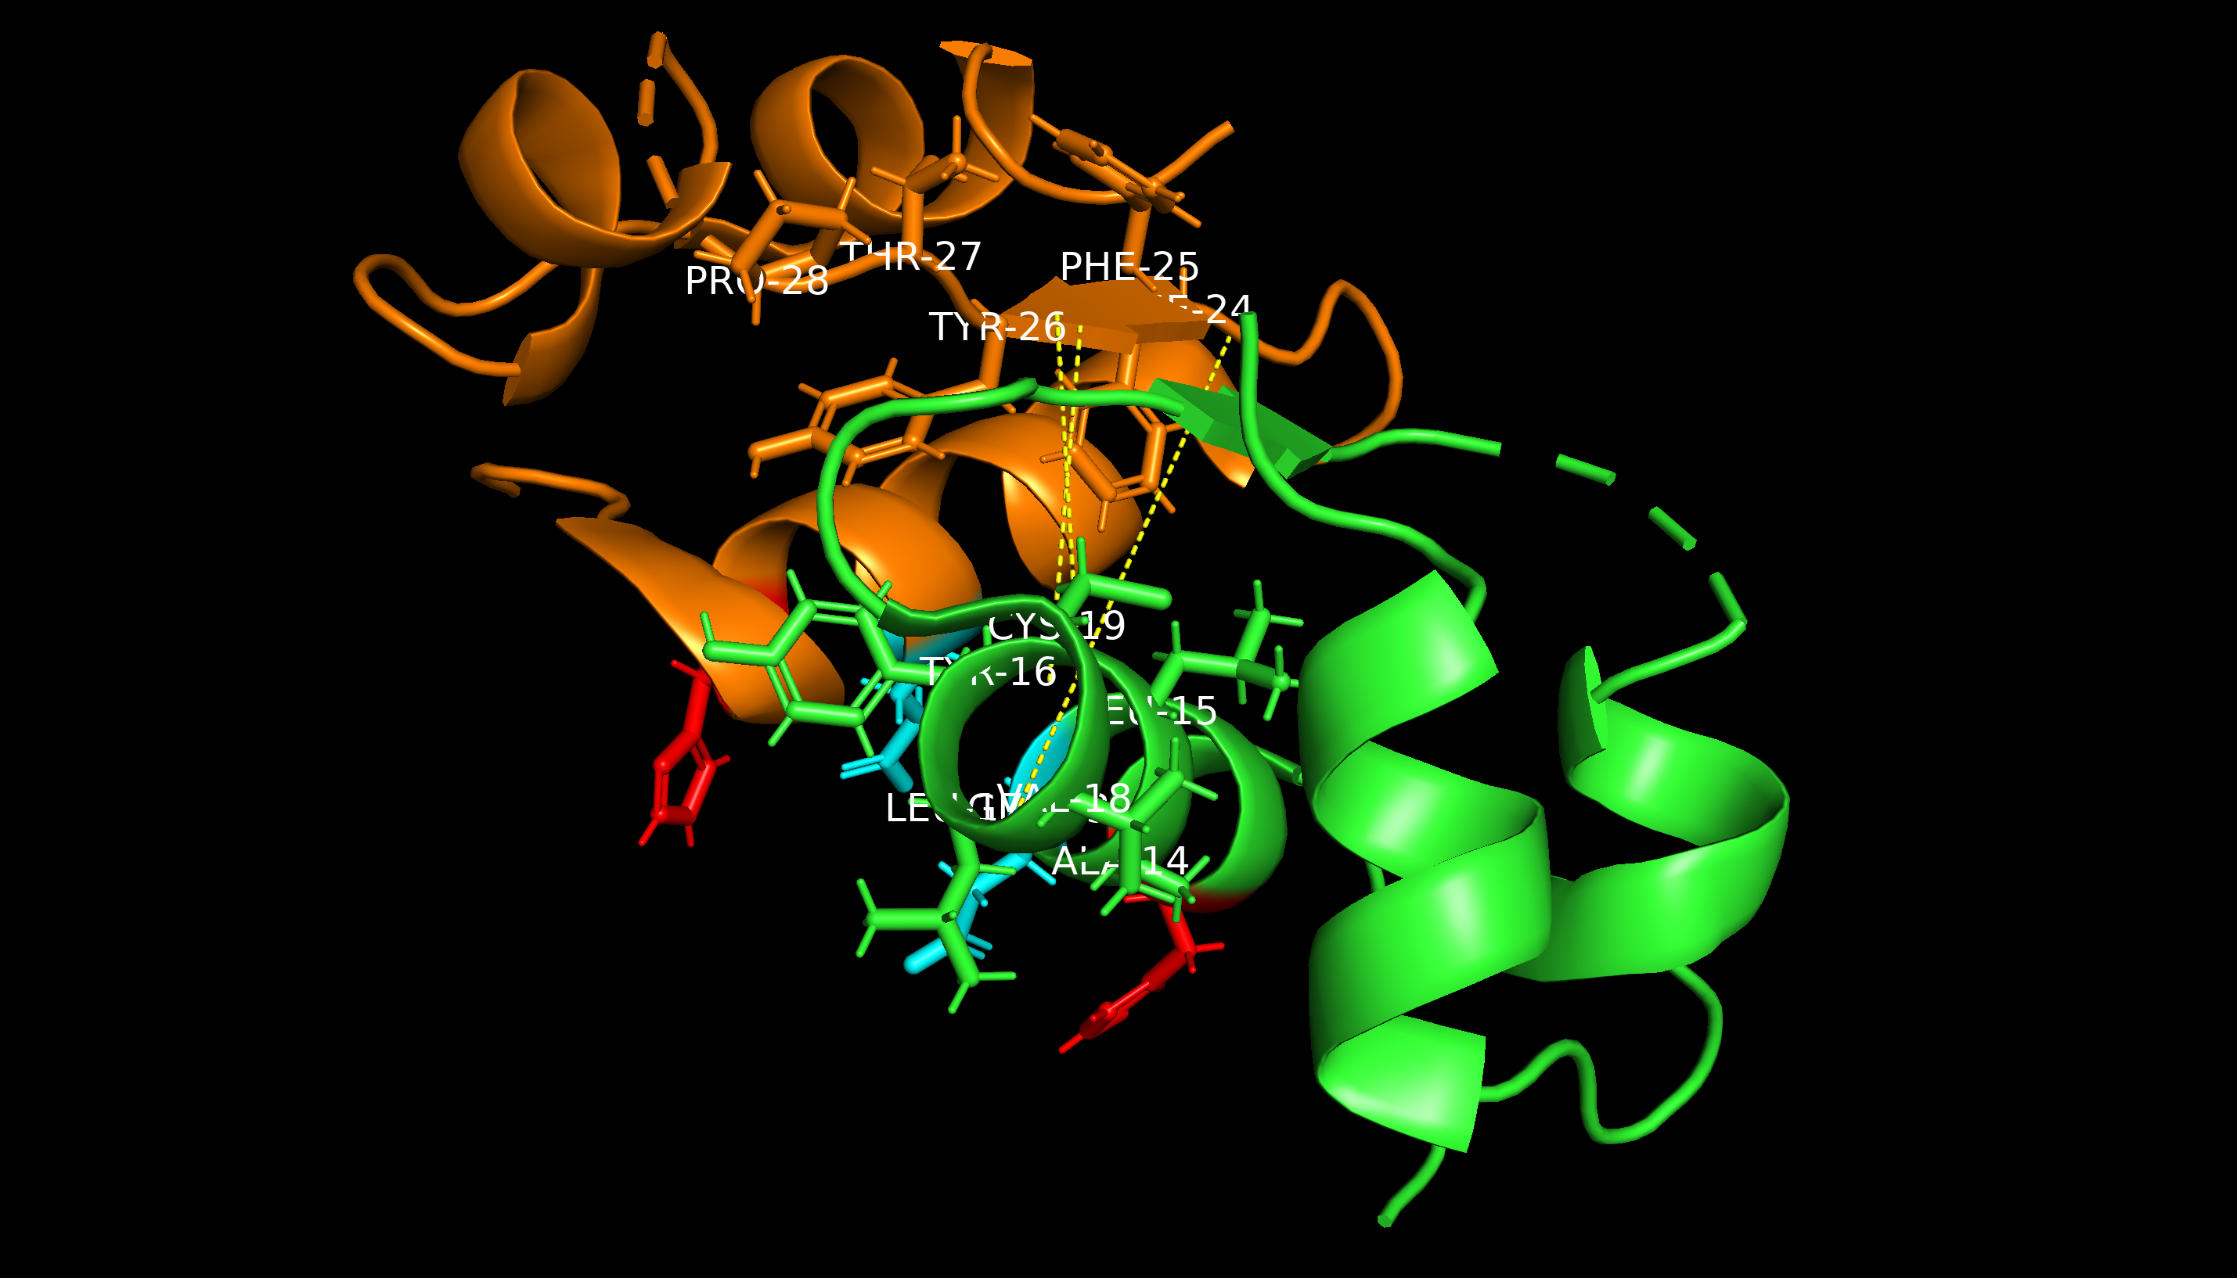

Slide 7

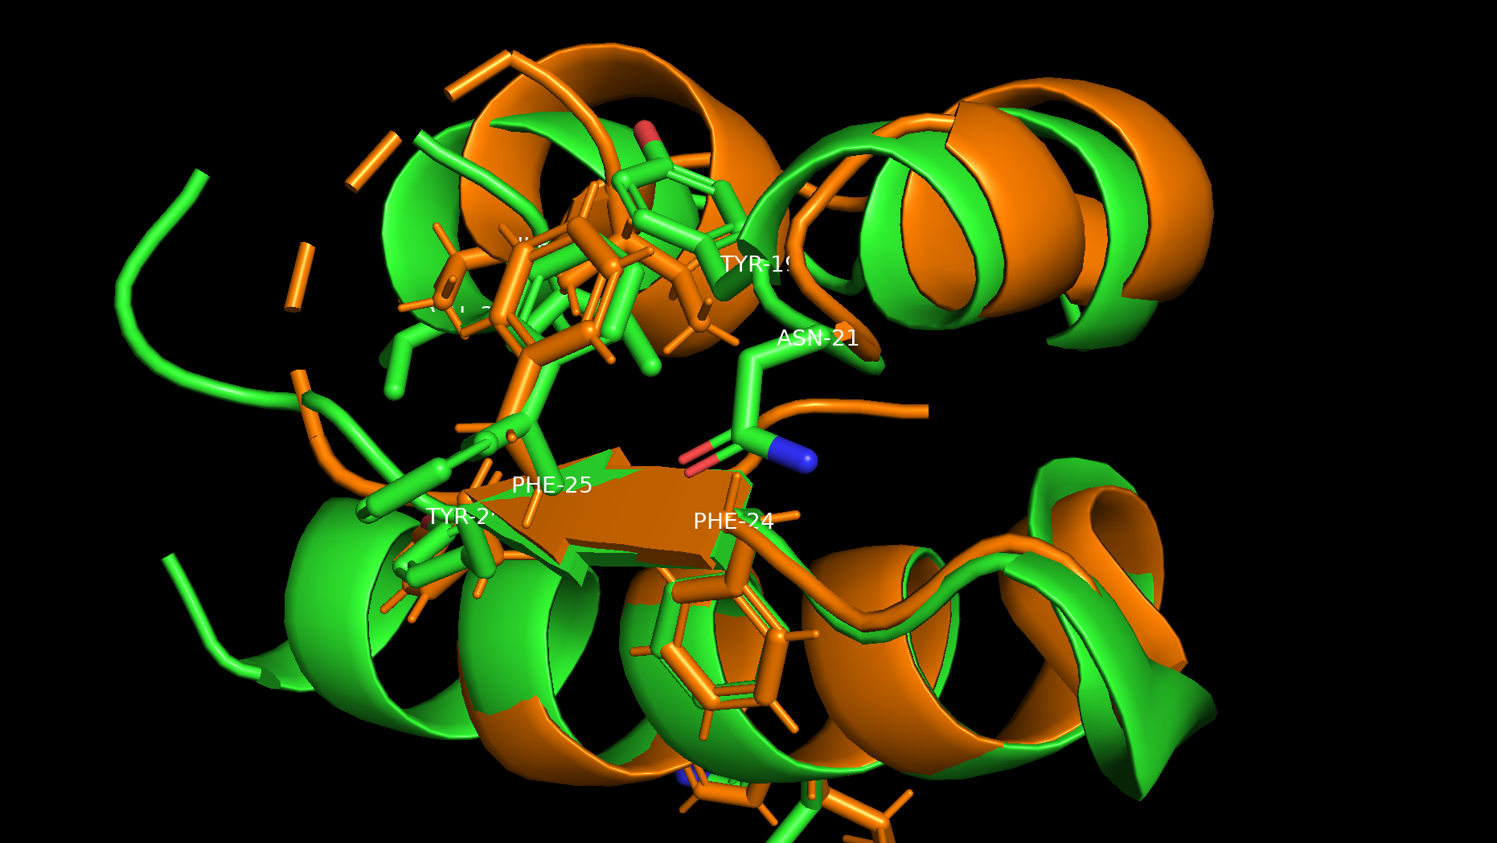




Slide 8
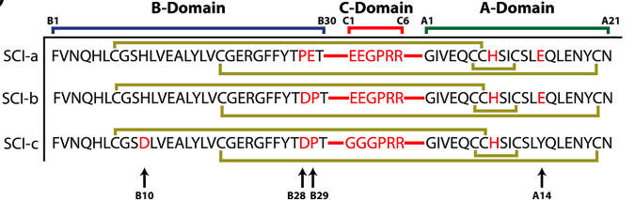
6 residue linker domain
Glutamates introduce negative charges to lower isoelectric point and reduce interaction with Insulin-like growth factor 1 (IGF-R1)
Reduces mitogenicity and carcinogenesis in mice models.
GPRR designed to prioritize structural flexing/folding to allow A and B chain alignment during receptor binding
SCI-a/b demonstrated as final proof of concept, with b meant for ease of characterization
C resulted from prior prototypes
Changes to HisB10 correlated with mitogenicity and carcinogenesis in mice models.

Slide 9
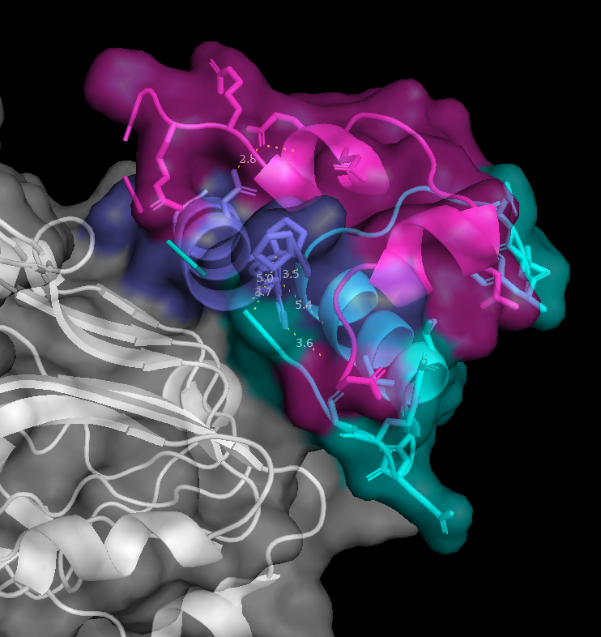
Amino acids in Receptor binding
SCI containing PheB24, PheB25, and TyrB26, and ArgC5/6
Past studies inspected binding to a simplified/truncated micro insulin receptor (µIR)
Composed of L1/L2 domain (white), ⍺CT peptide (blue)
Phe714 of ⍺CT hydrophobic interaction with PheB24.
Pro716 and 718 of ⍺CT engages with PheB25
PDB: 7KD6
Notes:
Ive covered quite about SCI57 itself, but I wanted to highlight some information about the receptor itself. This receptor shown here is a truncated version of the total hIR that was used to study binding affinity of SC57 with residues directly involved with receptor binding. The simplified receptor here is composed of an L1/L2 domain shown in white, with the aCT peptide shown in purple/blue. Residues such as PheB24/25 and TyrB26 interact with residues Phe714, Pro716, and Pro718 on the aCT peptide to initiate binding. Ive covered quite about SCI57 itself, but I wanted to highlight some information about the receptor itself. This receptor shown here is a truncated version of the total hIR that was used to study binding affinity of SC57 with residues directly involved with receptor binding. The simplified receptor here is composed of an L1/L2 domain shown in white, with the aCT peptide shown in purple/blue. Residues such as PheB24/25 and TyrB26 interact with residues Phe714, Pro716, and Pro718 on the aCT peptide to initiate binding.

Slide 10
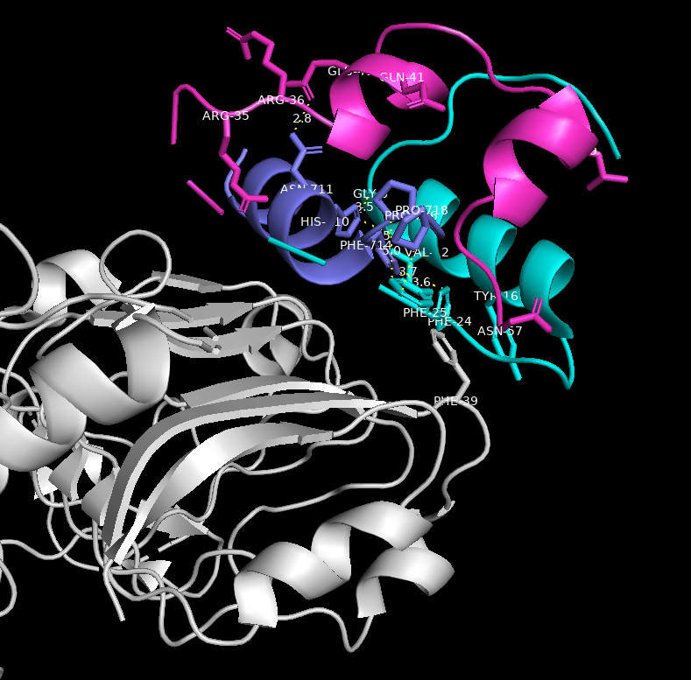
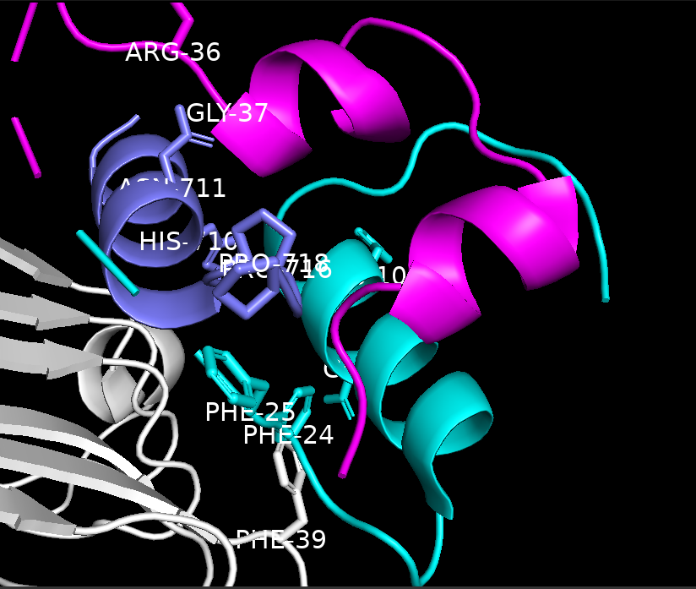
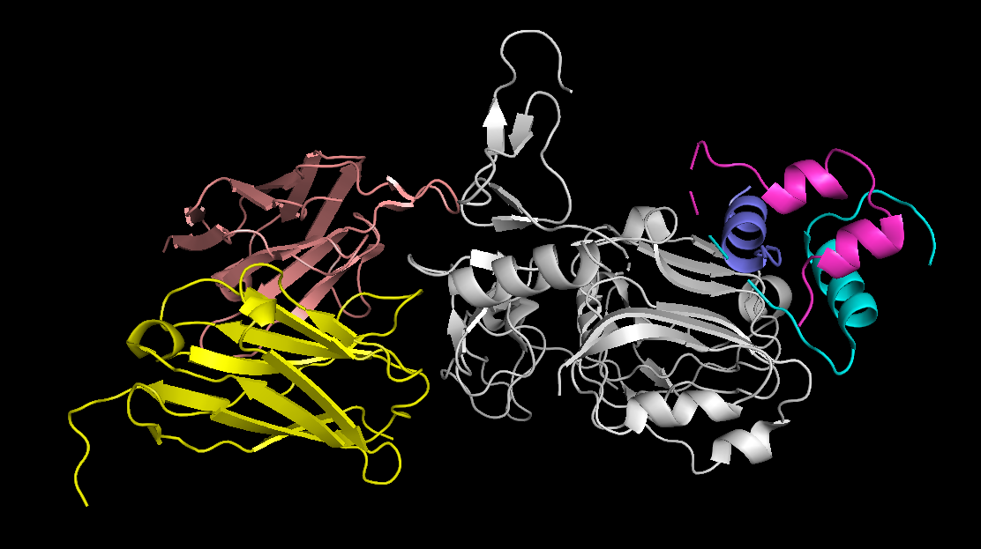
PDB: 7KD6
Notes:
Fv heavy chain in yellow, and Fv light chain in peach. The presence of the variable region of an antibody binding region was meant to stabilize the domain-minimized insulin receptor. This was needed to prevent aggregation during crystallization for analysis with X-ray crystallography
Providing electron density for regions that may have been disordered during characterization allowed for a well resolved structure in the 7KD6 PDB file.

Slide 11
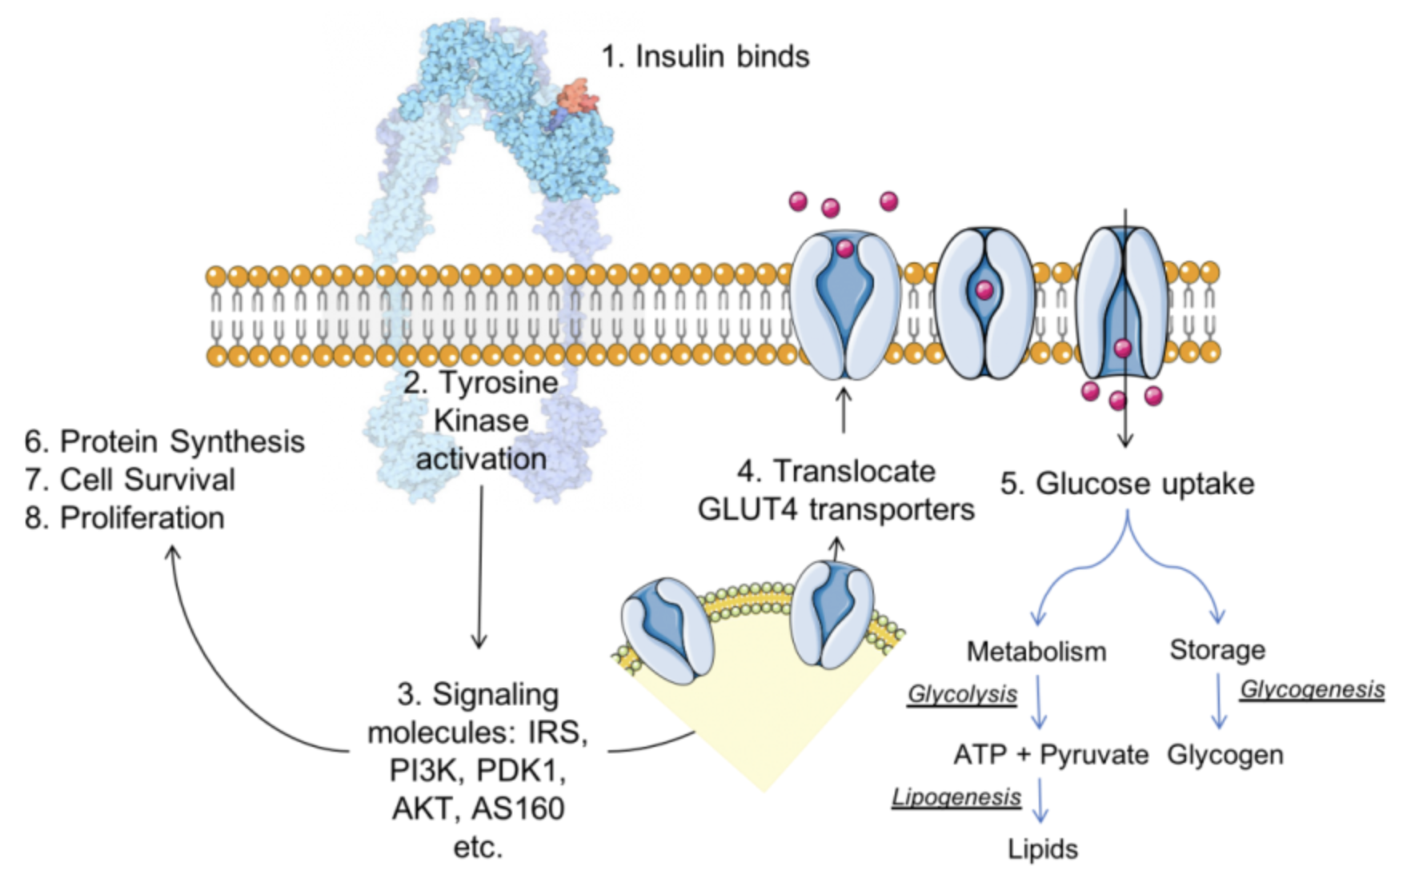
Functional Information
Ligand, secondary messenger
Insulin and receptor binding → Conformational Change
Signaling pathway for insulin$.^{3}$

Slide 12
Academic and Industrial Values
Informs next-generation design of insulin and other pharmaceutical medications
Tailored pharmacological profiles
Provides rationalized development to understand structure and factors influencing folding, stability, and function to larger biomolecular engineering field.
Notes:
Some promising academic values behind studying SCIs are that they can inform next generation design of insulin medication that can have tailored pharmacokinetic/dynamic profiles. Understanding insulin-receptor interactions further a foundation in being able to rationally develop therapeutics with optimized receptor engagement.
Additionally, further studies of SCIs can help to explore how structural modifications to proteins can influence folding, stability, and function. These together contribute to advancements not limited only to diabetes treatments but also protein engineering as well.

Slide 13
Academic and Industrial Values
Modulated biological activity for diverse patient needs
Led to rapid acting such as lispro or long lasting like icodec
Covers post-meal glucose spikes and maintaining glucose homeostasis between meals.
Furthering understanding of SCI, heat resistant, addresses a larger problem facing the pharmaceutical industry: heat degradation.
Potentially provides insights to develop other robust medications
Notes:
Industrially, insulin analogs have revolutionized diabetes care and the pharmaceutical industry as a whole. Advances in development have allowed us to modulate their biological activity, from rapid acting to ultra long lasting. Depending on the need at hand for the patients, rapid acting (bolus) insulin can cover post-meal glucose spikes, with long-lasting (basal) insulin maintaining glucose homeostasis between meals and preventing nighttime hypoglycemia.

Slide 14
Mission
SCI-57 with WT pharmacokinetics
Modulating this property to observe potential rapid acting nature while preserving biological activity and thermal stability.
Rapid acting determined by:
Residues promoting hexamer assembly
Fatty acid attachment to delay absorption
Effective binding to receptor residues
Engineer an insulin analog with residues encouraging one of the criteria while maintaining properties of SCI-57.
Notes:
There are various factors that can determine an engineered insulin molecule’s ability to rapidly act, including but not limited to: residues that promote hexamer formation and attachments of fatty acids to encourage hexamer formation and delay absorption.
Such modifications can help meet diverse needs of diabetic patients who require different insulin action profiles to optimize glycemic control in their medication regiment.

Slide 15
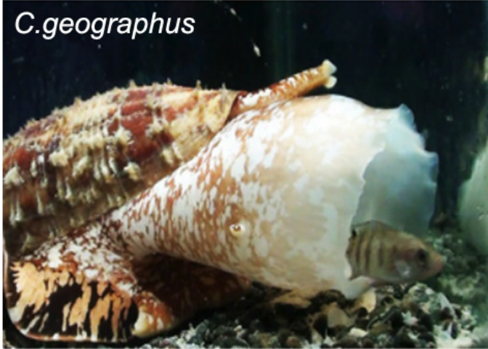
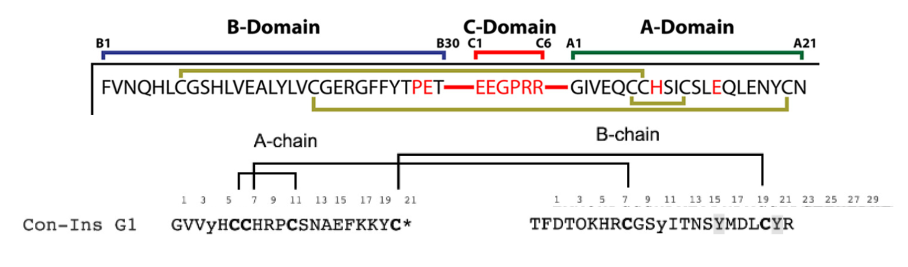
Mission
Fishing hunting cone snails inducing rapid hypoglycemia
Characterized by rapid pharmacokinetic action and effective binding affinity to receptors.
Venom containing specialized insulins/homologs
Receptor binding affinity facilitated by tyrosines at B15/20
C. geographus, species of cone snail. (13)
Sequencing of venom specialized insulin. (13)
Notes:
Moving forward, I needed some guidance, and I needed some direction for where to potentially introduce a mutation within SCI-57

Slide 16
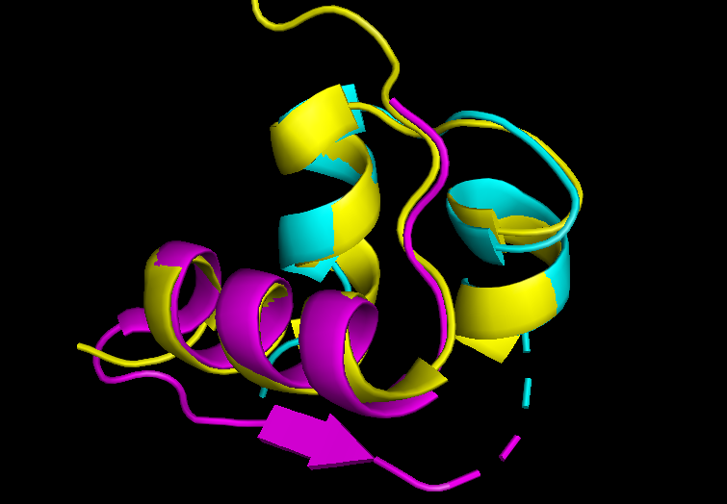
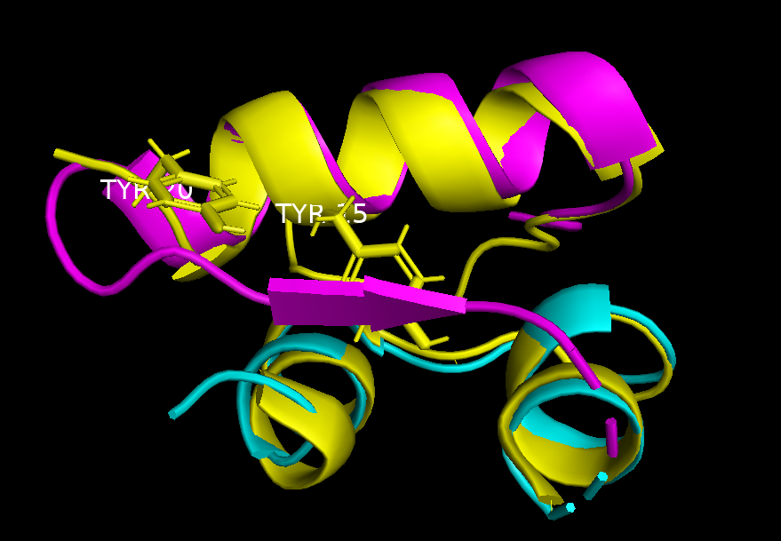
PDB 5JYQ
PDB 5JYQ
Structural overlay of SCI-57 with Con-ins. Con-ins is shown in yellow, and the B chain of the SCI is shown in magenta. A chain of the SCI is shown in cyan. The C domain linker is indicated by the dashed lines.

Slide 17
Hypothesis
Mutating residues at B15 or 20, typically considered to be non-essential in insulins, in SCI-57 will improve the binding affinity and lower time of action while preserving its thermal stability and biological activity.

Slide 18
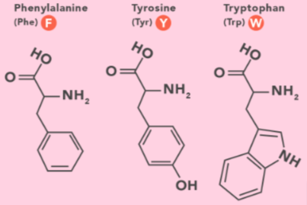
Mutation Strategy
“…loss of aromatic side chains at positions B15 and B20 results in lower binding affinity and potency at the hIR.” (Ahorukomeye et Al., 13)
Limit mutations to aromatic residues within SCI-57

Slide 19
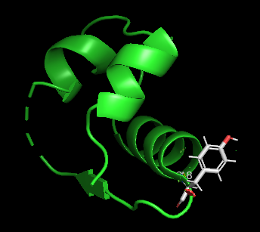
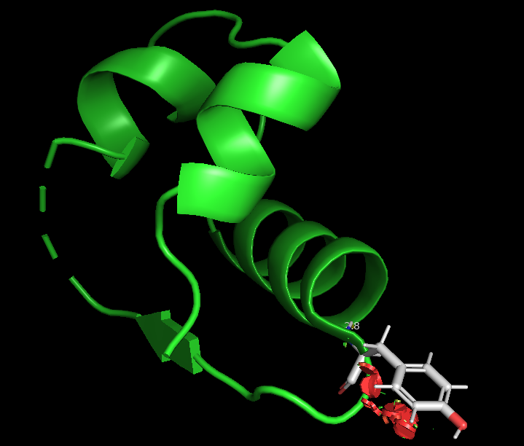
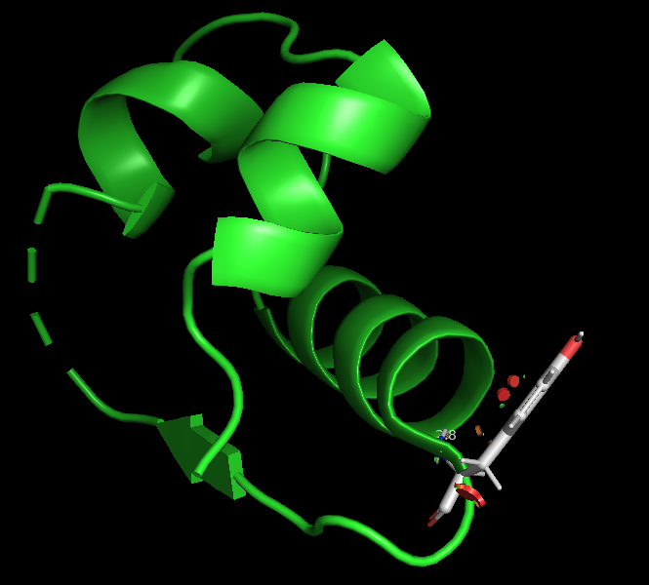
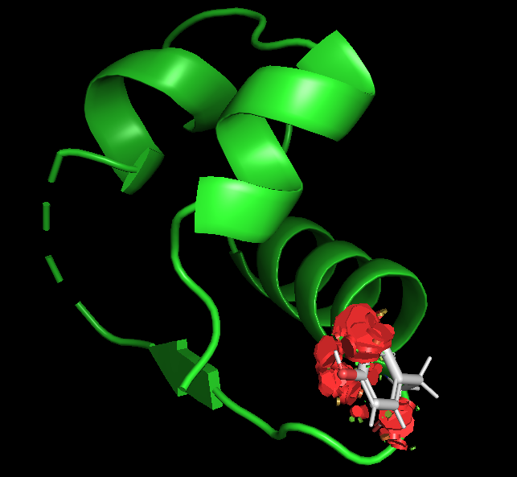
Tyrosine
2. 42.22
1. 21.85
3. 23.68
4. 95.43

Slide 20
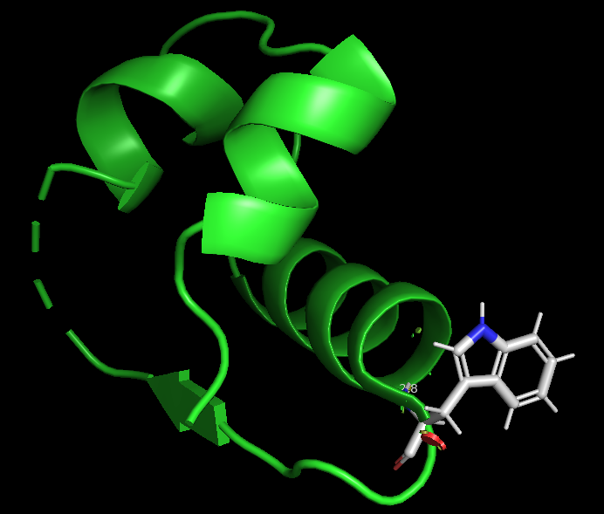
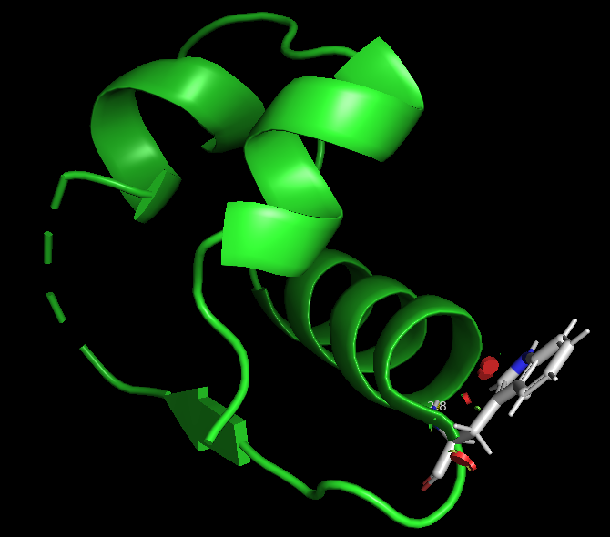
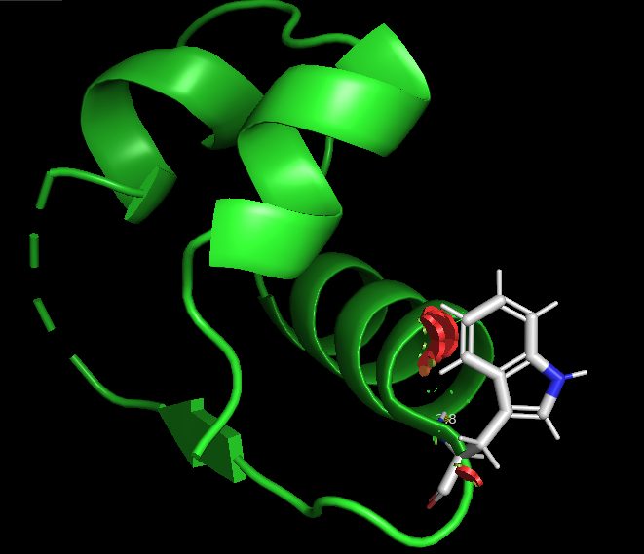
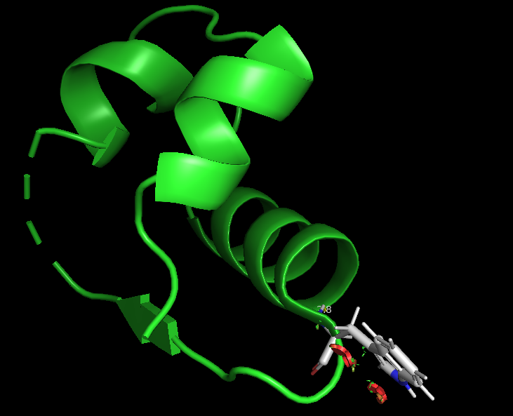
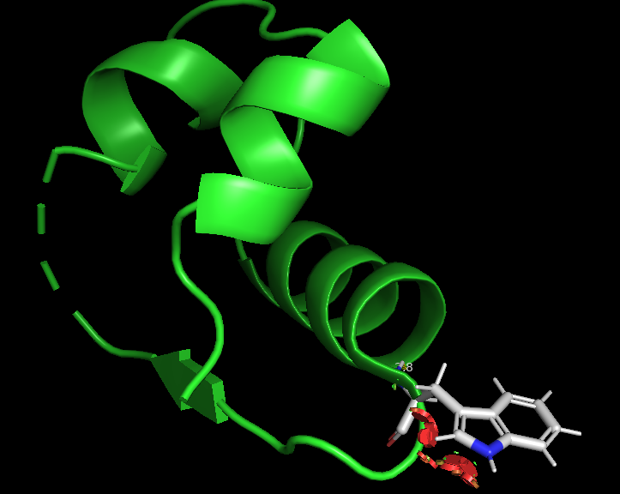
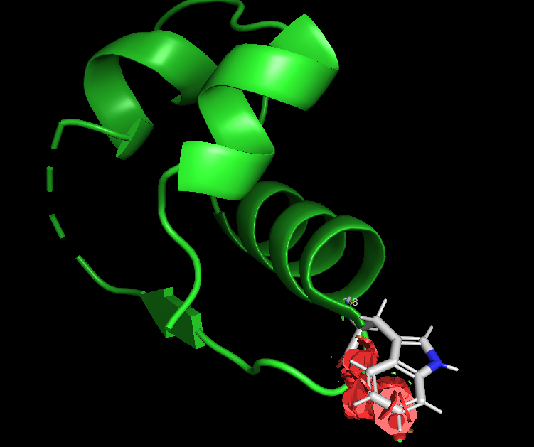
Tryptophan
14.26
2. 16.36
3. 27.31
4. 24.59
5. 70.56
6. 18.16

Slide 21
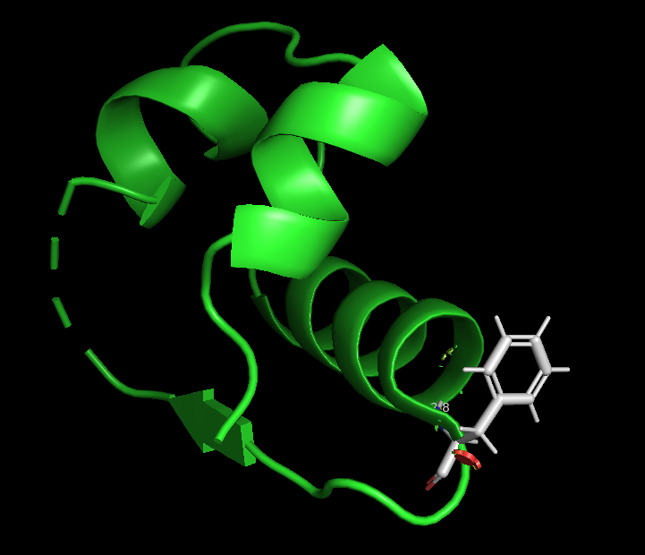
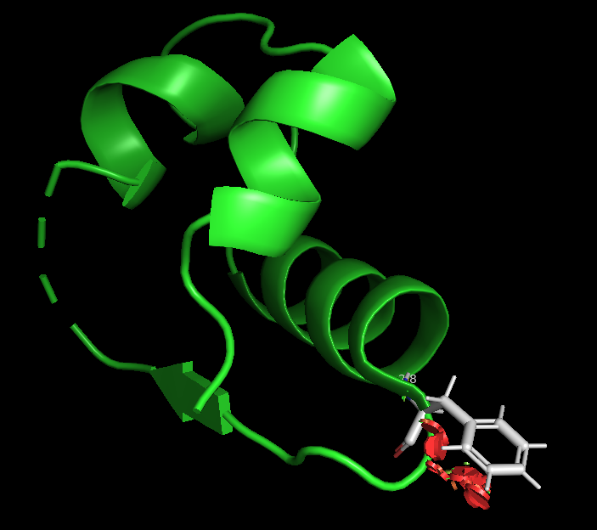
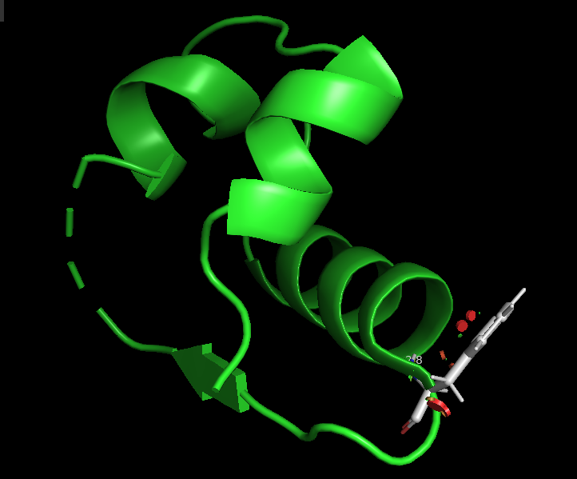
Phenylalanine
19.12
3. 40.70
2. 21.49

Slide 22
ClusPro Docking
SCI-57 mutant | Weighted Docking Score
Gly (original) | -817.7
Trp | -894.1
Tyr | -881.1
Phe | -889.4
Simlulated docking with new energy minimized mutants.
Promising results?

Slide 23
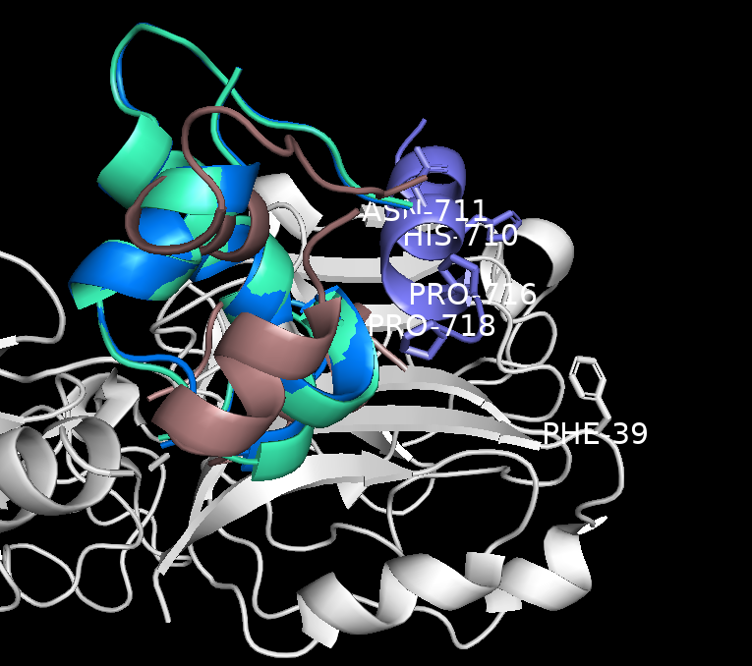
ClusPro Docking
Docking position of lowest energy conformation moved the mutated SCIs away from receptor residues.
Phe mutation in cyan
Tyr mutation in brown
Trp mutation in blue
Mutation bulk outweighing electrostatic interactions
Highlights glycine role in chain turning at B20
Idealized SCI-receptor binding
ClusPro generated results
Notes:
introduction of aromatic residues that were suggested to enhance binding within Con-Ins-receptor complexes struggled to balance flexibility with binding interactions.
Though promising at first, subsequent simulations through PyMol and ClusPro indicated that mutation of GlyB20 on SCI-57 may not be viable as it renders the conformation to be unfavorable during SCI-receptor docking. Glycine as an amino acid contains only 1 hydrogen atom within its side chain, making it much smaller than the mutations introduced.
These introduced amino acid mutations, while suggested to contribute to strengthened binding affinity and potency in Con-Ins, ended up hindering this by their effect on the ß-turn at position 20 to 23 on the B chain.
The obtained data, while promising numerically, provided validation of that that hypothesis was likely not correct. Movement of mutated SCI-57 molecules at the B20 positions altered the locations of the energy minimized dockings between them and insulin receptors. This suggests the incompatibility of mutagenesis of this kind. While discouraging, the results obtained from these simulations highlighted the critical need for flexibility within the protein structure at the B20-B23 region. This region demands this greatly, and that function is supported by amino acids like GlyB20 in SCI-57 that trade idealizing binding interactions for flexibility by minimizing steric clashes.

Slide 24
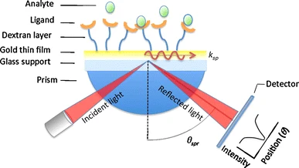
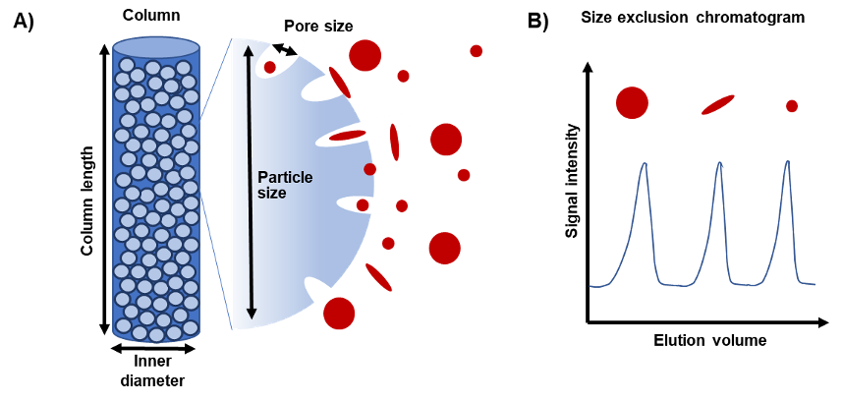
Testing and Evaluation
Quantify binding affinity/potency
Surface plasmon resonance to measure Ka, Kd, KD.
Incubation and Separations
Measure aggregation/cluster size under heat.
Surface plasmon resonance diagram. (19)
Size exclusion chromatography diagram. (20)

Slide 25
References
Mahase, E. Type 1 diabetes: Global prevalence is set to double by 2040, study estimates. BMJ 2022, 378, o2289. (BMJ)
Sun, H.; Saeedi, P.; Karuranga, S.; Pinkepank, M.; Ogurtsova, K.; Duncan, B. B.; Stein, C.; Basit, A.; Chan, J. C. N.; Mbanya, J. C.; Pavkov, M. E.; Ramachandran, A.; Wild, S. H.; James, S.; Herman, W. H.; Zhang, P. IDF Diabetes Atlas: Global, regional and country-level diabetes prevalence estimates for 2021 and projections for 2045. Diabetes Res. Clin. Pract. 2022, 183, 109119. (Diabetes Research and Clinical Practice)
Type 1 Diabetes: Causes, Symptoms, Complications & Treatment. Cleveland Clinic. https://my.clevelandclinic.org/health/diseases/21500-type-1-diabetes (accessed 2024-09-27).
Glidden, M. D.; Aldabbagh, K.; Phillips, N. B.; Carr, K.; Chen, Y.-S.; Whittaker, J.; Phillips, M.; Wickramasinghe, N. P.; Rege, N.; Swain, M.; Peng, Y.; Yang, Y.; Lawrence, M. C.; Yee, V. C.; Ismail-Beigi, F.; Weiss, M. A. An Ultra-Stable Single-Chain Insulin Analog Resists Thermal Inactivation and Exhibits Biological Signaling Duration Equivalent to the Native Protein. Journal of Biological Chemistry 2018, 293 (1), 47–68. https://doi.org/10.1074/jbc.M117.808626.
Bin Xu, Shi-Quan Hu, Ying-Chi Chu, Shuhua Wang, Run-ying Wang, Satoe H. Nakagawa, Panayotis G. Katsoyannis, Michael A. Weiss; Diabetes-Associated Mutations in Insulin Identify Invariant Receptor Contacts. Diabetes 1 June 2004; 53 (6): 1599–1602. https://doi.org/10.2337/diabetes.53.6.1599
Solution structure of an ultra-stable single-chain insulin analog connects protein dynamics to a novel mechanism of receptor binding Glidden, Michael D. et al. Journal of Biological Chemistry, Volume 293, Issue 1, 69 - 88
Smith, N. A.; Menting, J. G.; Weiss, M. A.; Lawrence, M. C.; Smith, B. J. Single-Chain Insulin Analogs Threaded by the Insulin Receptor αCT Domain. Biophysical Journal 2022, 121 (11), 4063–4077. https://doi.org/10.1016/j.bpj.2022.09.038.
Jarosinski, M. A.; Chen, Y.-S.; Varas, N.; Dhayalan, B.; Chatterjee, D.; Weiss, M. A. New Horizons: Next-Generation Insulin Analogues: Structural Principles and Clinical Goals. J. Clin. Endocrinol. Metab. 2022, 107 (4), 909–928. https://doi.org/10.1210/clinem/dgab849.
Hirsch, I. B.; Juneja, R.; Beals, J. M.; Antalis, C. J.; Wright, E. E. Evolution of Insulin and How It Informs Therapy and Treatment Choices. Endocr. Rev. 2020, 41 (5), 733–755.
Kobayashi, M., Sasaoka, T., Sugibayashi, M., Iwanishi,M., and Shigeta,Y. (1989) Receptor binding and biologic activity of biosynthetic human insulin and mini-proinsulin produced by recombinant gene technology. Diabetes Res. Clin. Pract. 7, 25–28 Cross Ref Medline
Bajaj, H. S.; Goldenberg, R. M. Insulin Icodec Weekly: A Basal Insulin Analogue for Type 2 Diabetes. touchREVIEWS in Endocrinology 2023, 19 (1), 4. https://doi.org/10.17925/EE.2023.19.1.4.

Slide 26
Menting, J. G.; Gajewiak, J.; MacRaild, C. A.; Chou, D. H.-C.; Disotuar, M. M.; Smith, N. A.; Miller, C.; Erchegyi, J.; Rivier, J. E.; Olivera, B. M.; Forbes, B. E.; Smith, B. J.; Norton, R. S.; Safavi-Hemami, H.; Lawrence, M. C. A Minimized Human Insulin-Receptor-Binding Motif Revealed in a Conus Geographus Venom Insulin. Nat Struct Mol Biol 2016, 23 (10), 916–920. https://doi.org/10.1038/nsmb.3292.
Ahorukomeye, P.; Disotuar, M. M.; Gajewiak, J.; Karanth, S.; Watkins, M.; Robinson, S. D.; Flórez Salcedo, P.; Smith, N. A.; Smith, B. J.; Schlegel, A.; Forbes, B. E.; Olivera, B.; Hung-Chieh Chou, D.; Safavi-Hemami, H. Fish-Hunting Cone Snail Venoms Are a Rich Source of Minimized Ligands of the Vertebrate Insulin Receptor. eLife 2019, 8, e41574. https://doi.org/10.7554/eLife.41574.
Kristensen, C.; Kjeldsen, T.; Wiberg, F. C.; Schäffer, L.; Hach, M.; Havelund, S.; Bass, J.; Steiner, D. F.; Andersen, A. S. Alanine Scanning Mutagenesis of Insulin. Journal of Biological Chemistry 1997, 272 (20), 12978–12983. https://doi.org/10.1074/jbc.272.20.12978.
Krishna Deepak, R. N. V.; Sankararamakrishnan, R. N-H···N Hydrogen Bonds Involving Histidine Imidazole Nitrogen Atoms: A New Structural Role for Histidine Residues in Proteins. Biochemistry 2016, 55 (27), 3774–3783. https://doi.org/10.1021/acs.biochem.6b00253.
Hua, Q. X.; Shoelson, S. E.; Inouye, K.; Weiss, M. A. Design of an Active Ultra-Stable Single-Chain Insulin Analog: Synthesis, Structure, and Therapeutic Implications. J. Biol. Chem. 2008, 283 (21), 14703–14716. https://doi.org/10.1074/jbc.M800865200.
Mao, R., Chen, Y., Chi, Z., & Wang, Y. (2019). Insulin and its single-chain analogue. Applied Microbiology and Biotechnology, 103(21-22), 8737–8751.
Weiss, M. A. (2022). New Horizons: Next-Generation Insulin Analogues: Structural Principles and Clinical Opportunities. The Journal of Clinical Endocrinology & Metabolism, 107(4), 909–924
What is SPR? How does SPR work? https://smacgigworld.com/blog/surface-plasmon-resonance.php (accessed 2024-11-30).
Goyon, A.; Beck, A.; Colas, O.; Sandra, K.; Guillarme, D.; Fekete, S. Evaluation of Size Exclusion Chromatography Columns Packed with Sub-3 Μm Particles for the Analysis of Biopharmaceutical Proteins. Journal of Chromatography A 2017, 1498, 80–89. https://doi.org/10.1016/j.chroma.2016.11.056.

